Slide 1
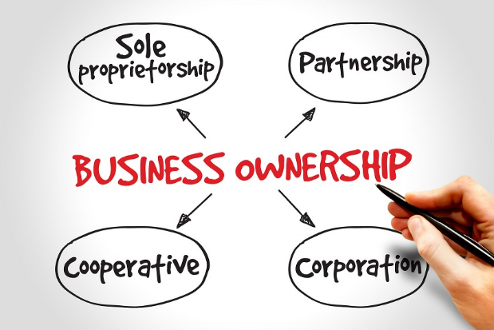
Ch. 6 Review Presentation
Introduction to Business

Slide 2
A business organization with two or more owners who share the risks and rewards.
partnership

Slide 3
Shares of ownership in a corporation.
stock

Slide 4
Buys and sells goods.
Intermediary, retailer

Slide 5
A business owned by one person.
Sole proprietorship

Slide 6
A business treated by law as a separate legal entity.
corporation

Slide 7
Business that change raw goods into more finished products.
processor

Slide 8
Turn raw or processed goods into finished products.
manufacturers

Slide 9
Full legal and financial responsibility for a business.
Unlimited liability

Slide 10
Financial responsibility only for what the owners of a corporation have invested.
Limited liability

Slide 11
A contractual agreement to sell a company’s products or services in a designated geographic area.
franchise

Slide 12
A business whose main purpose is to provide a service rather than to earn a profit.
Nonprofit organization

Slide 13
A group of small businesses banded together into a type of corporation.
cooperative

Slide 14
A business that gathers raw products in their natural state.
producer

Slide 15
A type of business that buys goods in large amounts and resells them to other business in smaller lots.
wholesaler

Slide 16
A type of business that buys goods from wholesalers or manufacturers and sells them directly to the public.
retailer

Slide 17
Number of Owners of a Sole Proprietorship
1 only

Slide 18
Advantages of a Sole Proprietorship:
Easy to start.
Be your own boss.
Keep all profits.
Taxes are quite low.

Slide 19
Disadvantages of a Sole Proprietorship:
Pay for everything yourself.
Unlimited Liability
Lack Business Skills

Slide 20
Number of Owners in a Partnership
2 or more

Slide 21
Advantages of a Partnership:
Share the risks & losses with your partner.
Pay taxes only on personal profits.
Easier to obtain capital
Each partner brings their own special skills & experiences to the business.

Slide 22
Disadvantages of a Partnership:
Share profits with partner(s).
You must get along with your partner.
A bad decision by a partner can affect you legally &/or financially.

Slide 23
Owners of a Corporation
Unlimited number of owners
They are called stockholders/shareholders

Slide 24
Advantages of a Corporation
Limited liability – stockholders can only lose what they have invested.
Corporation doesn’t end if the owners sell their shares.
Stockholders are paid dividends when their company makes a profit.

Slide 25
Disadvantages of a Corporation
Double taxation (higher taxes)
Government closely regulates corporations
Minimal say in the decisions of the company

Slide 26
Give me two examples of a franchise businesses
McDonalds, Subway, Taco Bell
Mobile Gas, Quick Fill

Slide 27
What is one positive aspect of taking part in a franchise?
Their well-known name.
A Business Plan.
Management training, advertising, & a system of operation.
It is easy to start.
The name of the parent company draws customers.

Slide 28
Why does a franchiser charge a franchisee to use their name?
It draws people in because of their well-known name.

Slide 29
Give me one way a non-profit organization is like a corporation.
Must register with the government.
May be run by a Board of Directors.

Slide 30
Give me one way a non-profit organization is unlike a corporation.
Doesn’t have to pay taxes because it doesn’t make a profit.
Relies on government grants & donations from businesses & individuals to raise $, not investors.
Donors don’t receive dividends like investors, but can deduct them from their taxes.

Slide 31
Give two advantages of a cooperative.
Doesn’t have to pay taxes because it doesn’t make a profit.
Relies on government grants & donations from businesses & individuals to raise $, not investors.
Donors don’t receive dividends like investors, but can deduct them from their taxes.

Slide 32
What is the difference between a producer and a processor?
Producers - A business that gathers raw products in their natural state.
From land & water – natural state
Processors – Change raw materials into more finished products.
Process raw materials.

Slide 33
What does a manufacturer do with raw or processed goods?
Businesses that make finished products out of processed goods

Slide 34
What does an intermediary do?
A business that moves goods from one business to another.
Wholesaler/Distributor - Buys goods from manufactures in huge quantities and resells them in smaller quantities to their customers.
Retailer - Purchases goods from a wholesaler & resells them to the consumer.

Slide 35
Give examples of service business.
Meet a Need
Medical Clinics
Law firms
Provide a Convenience
Taxi Companies
Copy Shops
Give Access to Information
Newspapers
Internet Services (Yahoo!!)

